Slide 1
We exist to prevent commercial sexual exploitation in countries of origin.
“get there before the trafficker”

Slide 3
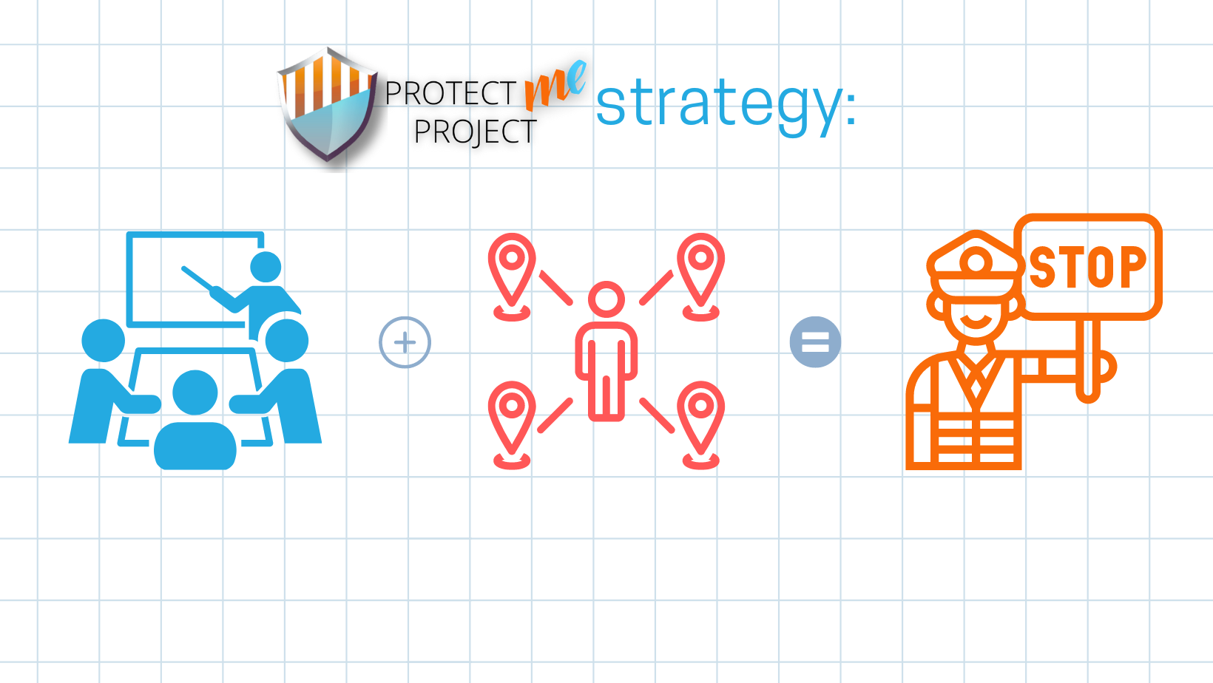
Capacity Building
Mobilization
Prevention

Slide 4
Prevention
Push & Pull Factors
Sexual Abuse of Minors (SAM)
Pornography creation and consumption
Risky online behaviors
Sexting
Grooming
Cyber bullying
Recruitment
Sexual violence and exploitation
START
Promoting human dignity & authentic freedom

Slide 5
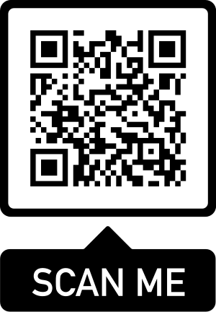
.ORG
“get there before the trafficker”
INFO.

